Slide 1
Business Models
Enterprise Management for Computer Scientists
Fall, 2017

Slide 2
What is a business model?

Slide 3
Business Model—Simplified Concept
“Narrative + Numbers”
—Joan Magretta
Power of storytelling—Sense-making
Revenue streams—Cost structures
When business models fail
Fail narrative test
Story doesn’t work (dotcom era, e.g. online pet food)
Fail numbers test
Profit and loss (P&L) don’t add up (Amazon)

Slide 4
Established Business Models (Patterns)
Digital enterprise (examples here)
Long tail (MySpace)
Multi-sided platforms (PayPal, Alibaba)
Razor & blades (Gillette)
Freemium (Flickr, Real Player, Skype)
Variants
Open source (Red Hat)
Insurance (Ghana)
Open business models (BMW)

Slide 5
Osterwalder’s Business Model Canvas (BMC)
Provides a template for developing new or defining existing business models
Analytical tool
Visual chart with nine key components describing a firm’s value proposition, infrastructure, customers, and finances
Initially proposed by Alex Osterwalder in 2008
Similar canvases have been introduced for specific business niches, such as the Lean Canvas

Slide 6
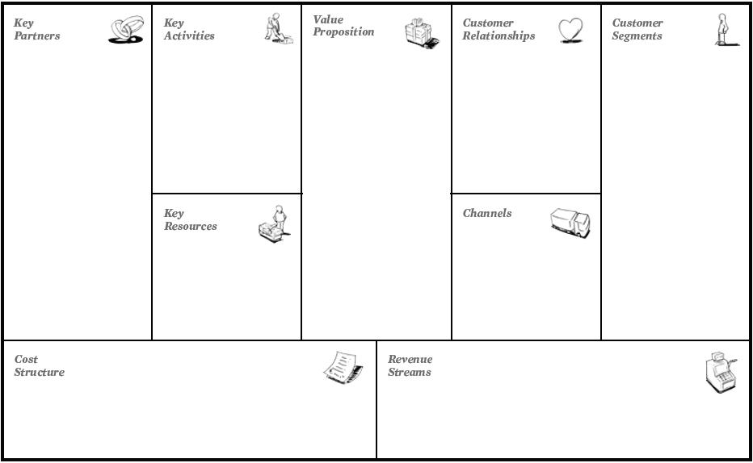
What problems need to be solved?
What product does it best?
Who are our suppliers and service providers?
What do we do with our resources?
How do we interact with our customers?
Who are our users and who are our paying customers?
What goods, services, and infrastructure do we use?
How do our customers find, buy, and use the product?
What is the total cost of production?
Where does our revenue come from?

Slide 7
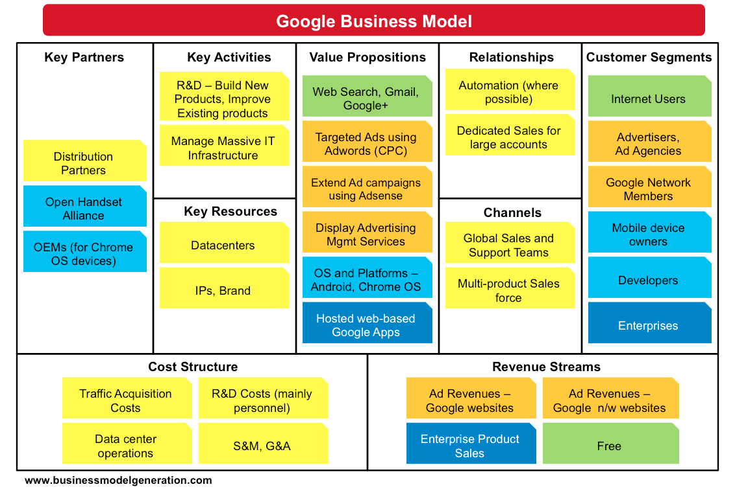

Slide 8
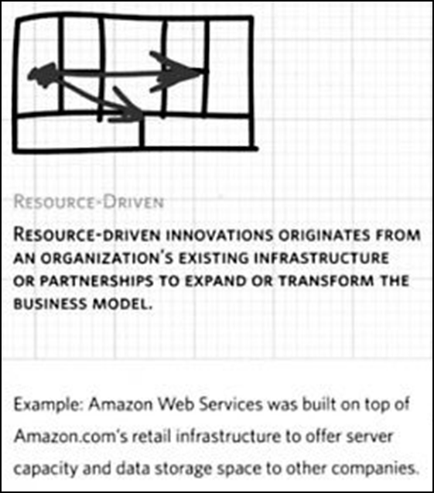
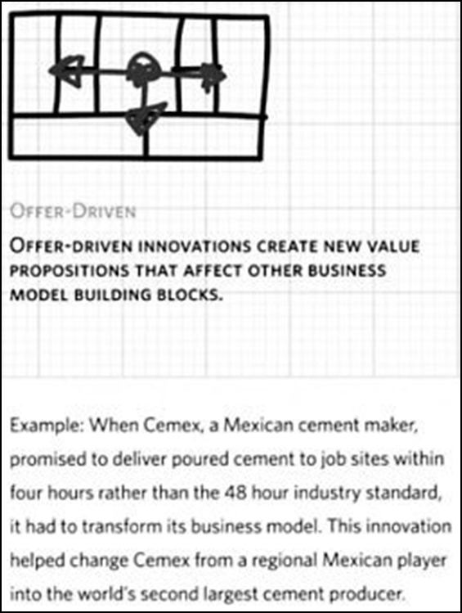
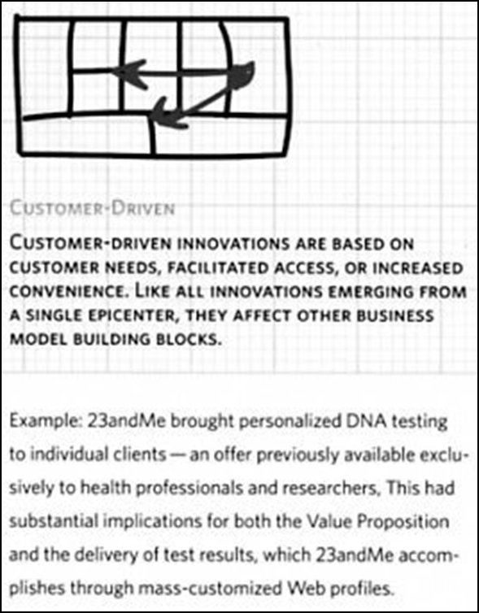
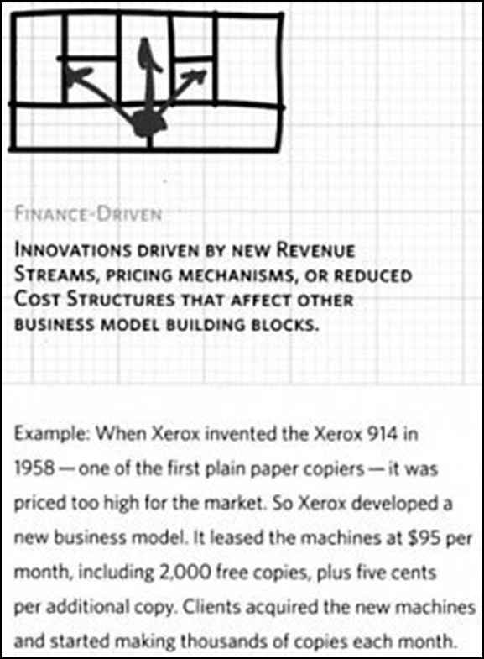
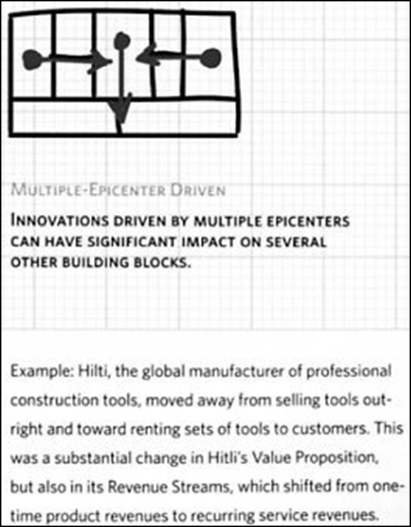
Epicentres of Business Model Innovation

Slide 9
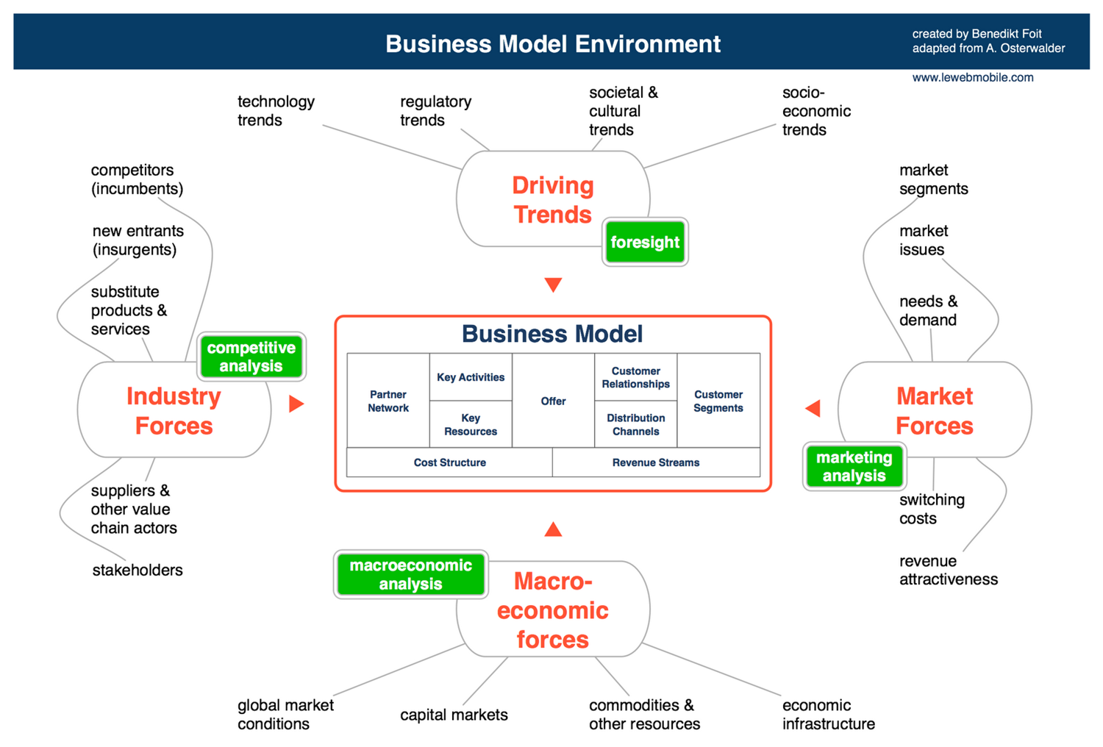

Slide 10
Augmented Product
Delivery
Installation
Actual Product
Feature
Core Benefits
After-sales support
Branding
Styling
Packaging
Quality
Warranty
Finance
Customer service

Slide 11
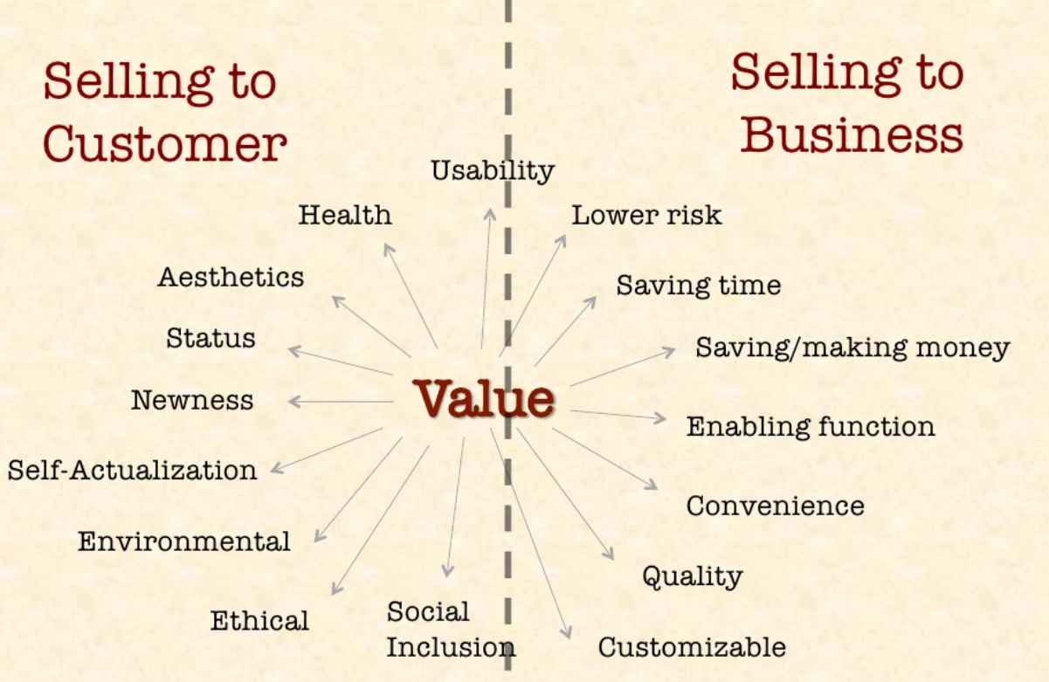

Slide 12
Value Propositions
A description of the bundle of products and services that create value for specific customer segments
What is the problem?
What is the solution?
How is value generated for the user?
Why should they select this solution over other possible solutions?

Slide 13
Bad Value Propositions
“Our mission is to deliver superior quality products and services for our customers and communities through leadership, innovation and partnerships.”
—Wendy’s mission statement
“We are unique in our commitment to helping our clients improve their organizations for the long term. We not only bring our clients new products and technology, but we also enhance their capacity for learning and change. The best measure of our success is that we create lasting value for our clients, their customers, employees and owners…”

Slide 14
Good Value Propositions
A good value proposition explains why your product is
Relevant (real problem)
Unique (original solution)
Valuable (quantified advantages)
“We help large companies reduce the cost of their employee benefits programs without impacting benefit levels. With the spiraling costs of health care today, this is a critical issue for most businesses. One of our recent clients, a large manufacturing company similar to yours, was struggling with how to reduce spending in this area. We saved them over $800,000 in just six months. Plus, they didn’t cut any services to their employees, nor did their employees have to pay more.”

Slide 15
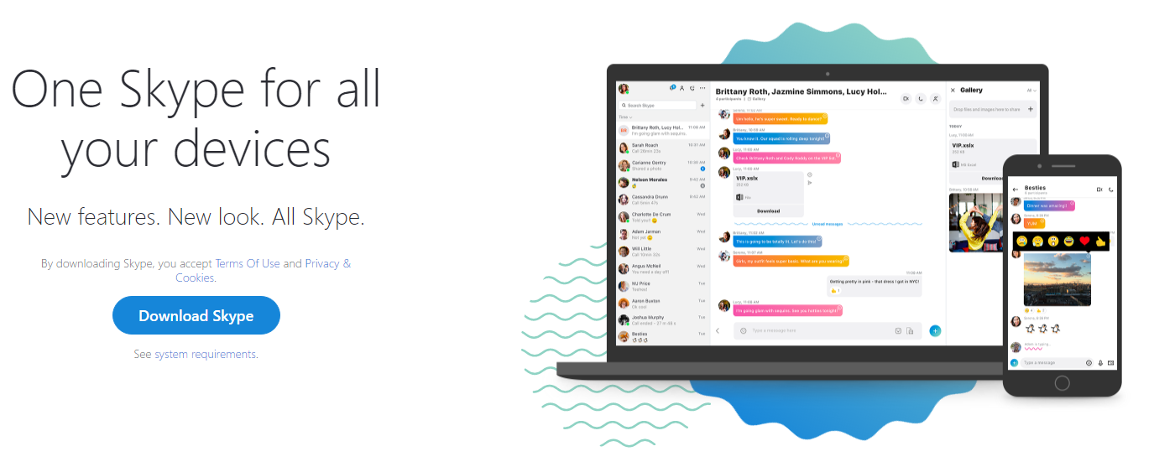
Good or Bad Value Proposition?

Slide 16
Writing a Good Value Proposition
For: senior management teams in secondary and independent schools
Who want to: continually improve the overall performance rating of their school
Our: behaviour management system
Provides: them with up-to-the-minute data on pupil behaviour and attendance, allowing them to proactively plan, communicate, and provide constant feedback and support to all staff, ensuring that all processes, procedures, and policies are effective, up-to-date, and consistently applied
Unlike: our competitors, our system is fast, easy to use, fully customisable, and paperless

Slide 17
For Next Time…
You will be working in groups to
Complete a business model canvas
Consider what’s missing from the model, and how to acquire it
Create a value proposition
Discuss how businesses could actually use the ‘completed’ canvas
What does/could it tell you?
How could it help you?

